Slide 1
Saving Ontario Energy
Team Carnation
Kyle Singer, Joseph Grosso,
Andrew Farley, Andrew Fryer

Slide 2
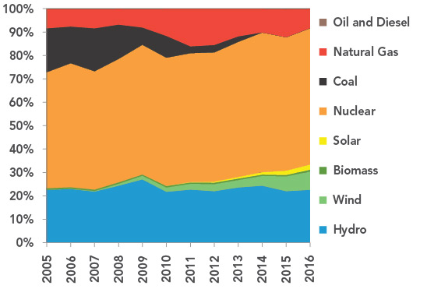
The State of Power in Ontario
https://www.cer-rec.gc.ca/nrg/sttstc/lctrct/rprt//prvnc/on-eng.html?fbclid=IwAR37Tb2017cndrnwblpwrsr0cra3_tkE3Coitl99T4YmAXpRIsDRJCxCf1lCOVCvNxl9weRkCA

Slide 3
Challenge
The goal of the challenge was to create a single power grid for all of Ontario, Canada that minimizes the greenhouse gas emission, cost of the electricity and maximizes the use of green energy producers to meet energy requirements.
The output of the solution was aimed at displaying how the various sources were used in each hour of a given day while optimizing the parameters above.

Slide 4
Solution Design Process
Step 1
Step 2
Step 3
Main parameters need to account for:
Meeting Power Requirements
Minimizing CO_2 Emissions
Minimizing Cost
Maximizing Green Energy Use
Optimizing power source choices to ensure ideal weighting. Designing an algorithm that accounts for the parameters outlined in step 1 with the given data.
Producing and testing of the algorithm (in Python) while accounting for potential anomalies and special cases.

Slide 5
1.
Our Solution
Making Ontario’s System Less Expensive and More Green

Slide 6
Solution - Algorithm Design
To quantify each power source we broke them into four parts:
Power Availability
Green Power Source
Cost of Source
CO2 Emissions
Each produced a score which allowed us to rank our sources from highest to lowest efficiency.
Nuclear was an exception, causing us to prioritize it first and look to predictions from the past to raise or lower production.

Slide 7
Solution - Priority Order
Hydro - 0.94
Wind - 0.86
Bio - 0.84
Nuclear - 0.69
Neighbor - 0.54
Solar - 0.47
Gas - 0.32

Slide 8
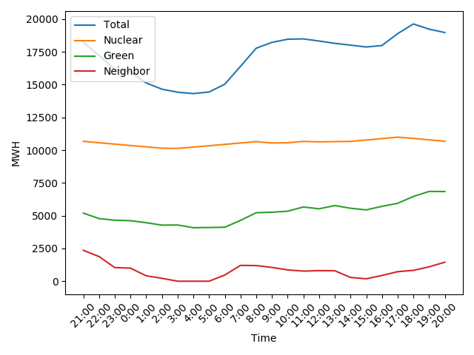
Solution - Data

Slide 9
Conclusion
Average hourly income: $479 000
Average hourly CO2 emissions: 1.39 million pounds
Average hourly demand: 17 800 MW

Slide 10
Next Steps
Calculate coefficients for weighting based on learning algorithm
Analyze past and future neighbour data to determine optimal time to sell energy
Create dynamic weighting based on parameters outside the scope of the project (i.e. length of days)
Further optimize method so to reduce reliant on non-green energies

Slide 11
Questions?

